Slide 1
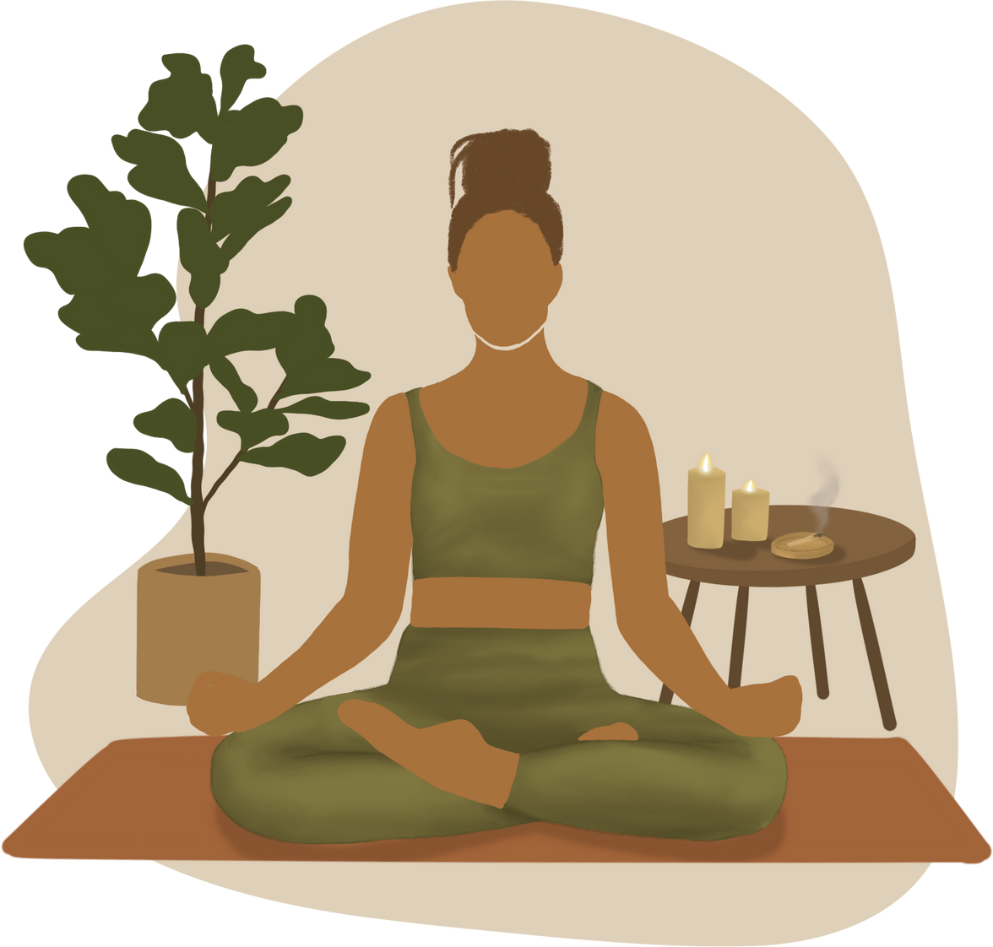
Yoga Pose Recognition from Videos
Group 6
Hashitha Shaikh
Pooja Pillay Shivakumar
Pranjali Desai
Pravalika Thota
Sritejaswi Kaparaboina
Vikas Charan Reddy

Slide 2


Table of Contents
Motivation of the Project
1
2
Research Questions
Data
3
4
Approach (Methods)
Results
5
6
Contribution & Implications
Challenges
7
Referenes
8

Slide 3




01
Motivation of the Project

Slide 4



Importance of Yoga Practice
01
Benefits of Yoga
Flexibility
Strength
Mental Clarity
Maximizes Benefits
Aids in Injury prevention
Improve effectiveness and safety
02
Increase in Popularity
Global Growth of Yoga-Rising popularity worldwide
Role of Technology- Enhances learning and instruction
Insights and feedback- Provides personalized guidance
03
Role of Technology
Machine Learning and Image Recognition- Automates Pose assessment
Real Time Feedback-Immediate, actionable insights
Empowering Independence:Supports Self guided yoga practice.

Slide 5


02
Research Questions

Slide 6
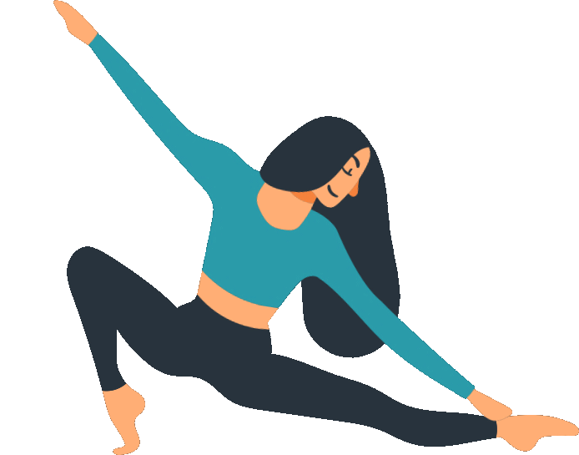
Key Questions Guiding Research
How to Achieve Accurate Recognition?
How to capture temporal features?
What Data is Essential?
The accuracy of yoga pose recognition depends on various factors like image quality and model training.
Ensuring diverse data representation can enhance model robustness.
Identifying essential features from videos that contribute to effective pose recognition is vital.
The use of both static and dynamic poses provides richer training data.
Capturing time-based features in yoga pose recognition involves training the model to understand the sequence of frames, using simpler labels for pose transitions, and distinguishing between dynamic and static poses. This requires a lot of testing and careful design of how the model is trained.

Slide 7

03
Data

Slide 8
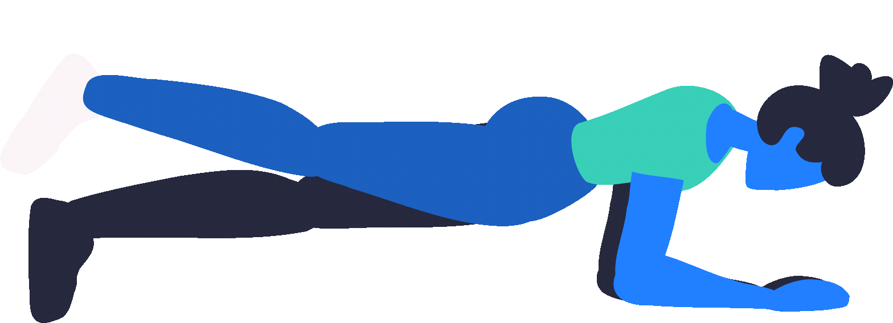
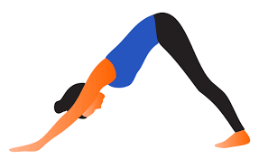

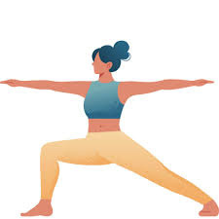
Dataset Description
5000 Train Images
1600 Test images
warrior2
plank
downdog
tree

Slide 9


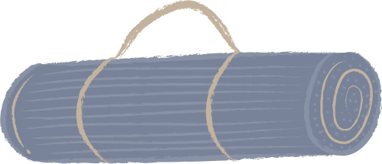
/
04
Approach

Slide 10





Process Overview: From Video Input to Pose Prediction
Data Collection and Keypoint Extraction
[(x1,y1,z1),(x2,y2,z2)]
Model Building and Training
Model Deployment and Video Input Handling
Pose Prediction from Video
Pose Correction

Slide 11






Data Collection Strategy
Sources of Data
Diverse datasets, including images and videos from Kaggle competition dataset, Sketchfab 3-D yoga models to capture poses from different angles, YouTube videos
Data Preprocessing Techniques
Images are standardized for size and quality to ensure effective training. Annotated data is required for supervised learning, highlighting different poses.
Privacy and Ethics Considerations
Ethical data usage and privacy rights was maintained throughout the project by using data from open-access platforms
Notes:
• The dataset consists of images and videos of various yoga poses, collected from publicly available sources or custom recordings. The data is organized into subfolders where each subfolder represents a specific yoga pose (e.g., Warrior, Downward Dog).
• For video inputs, images are captured at specific time intervals, and keypoints such as the positions of body joints (head, shoulders, knees, etc.) are extracted using the Mediapipe library. The keypoints are used as features for model training and prediction, allowing the system to classify yoga poses frame by frame as the video progresses.
•

Slide 12
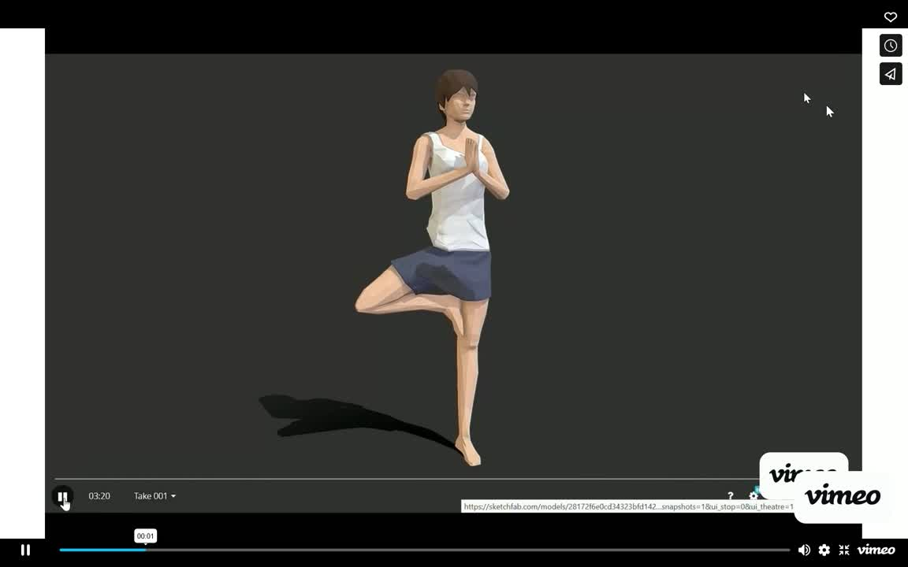
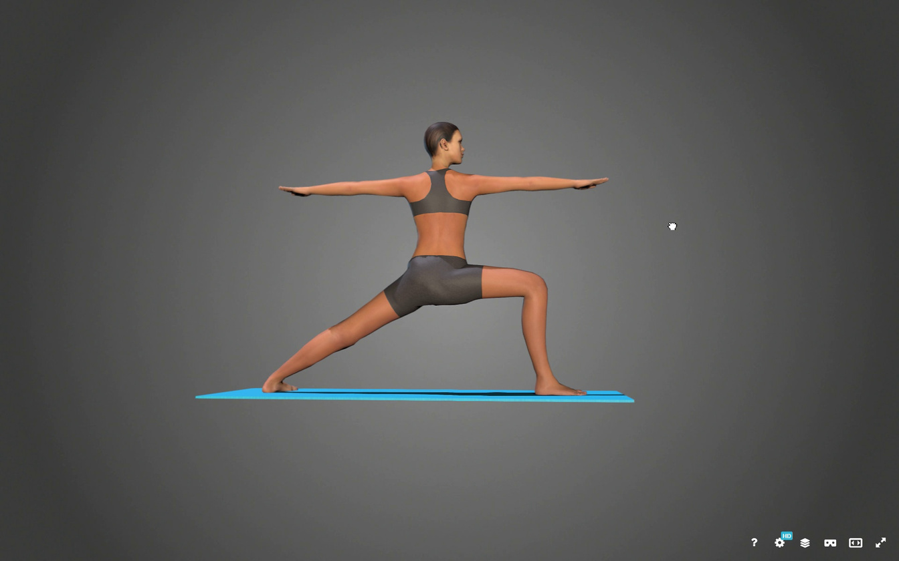
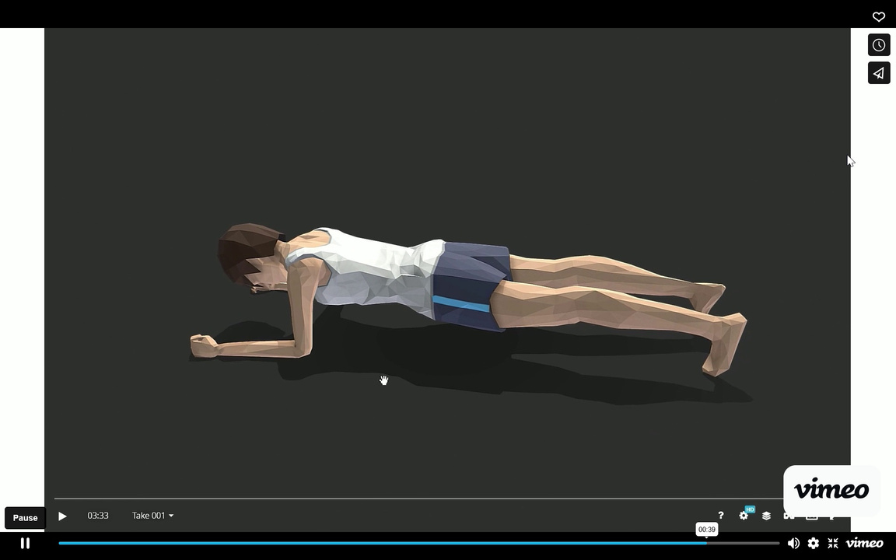
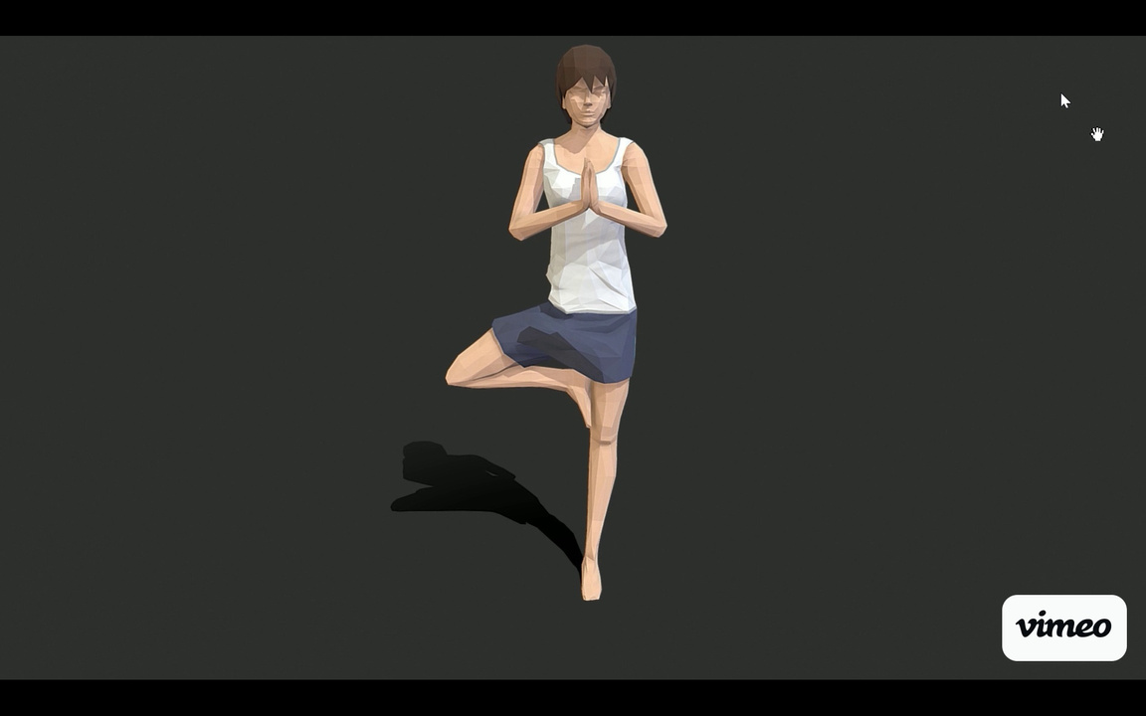
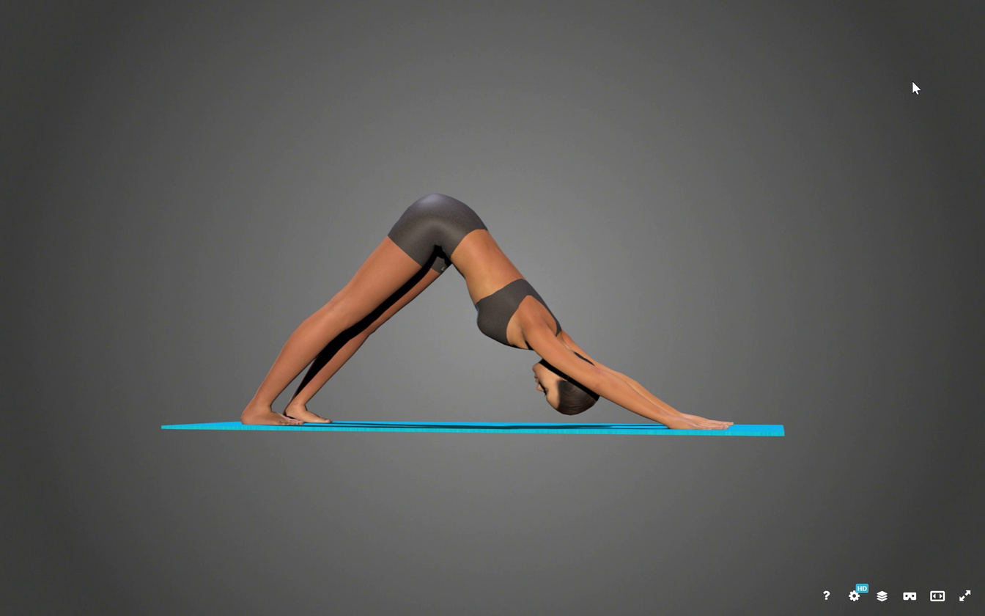
Frames from Video

Slide 13
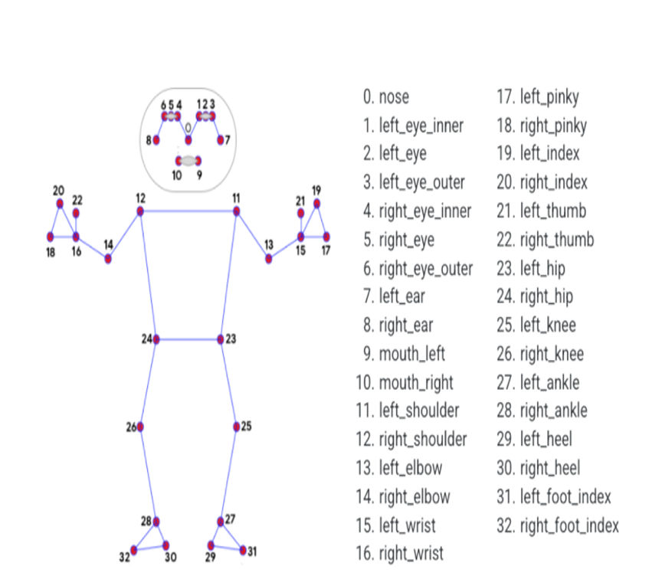
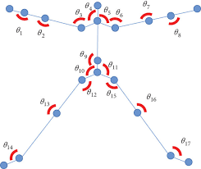
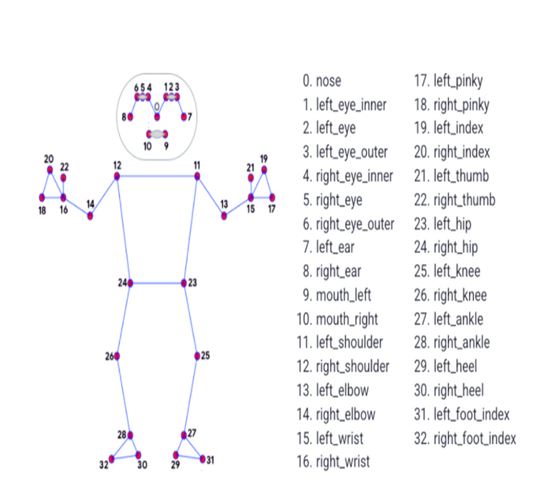
Keypoints and angles extraction
Each image- Keypoints extracted using Mediapipe library
Each image- Angles between joints calculated and collected as a recognition of pose in the image

Slide 14
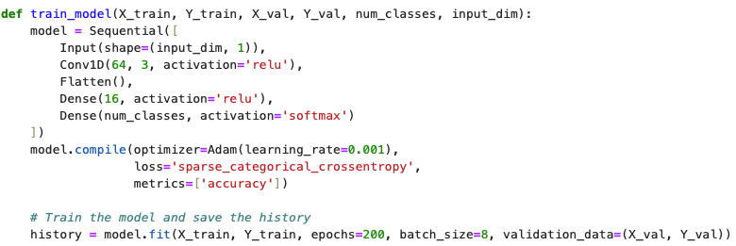
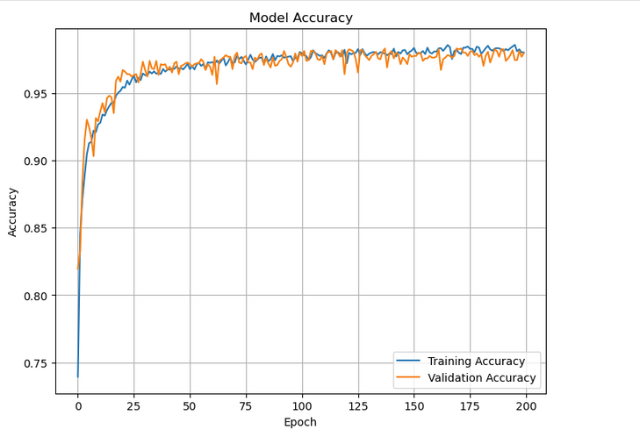
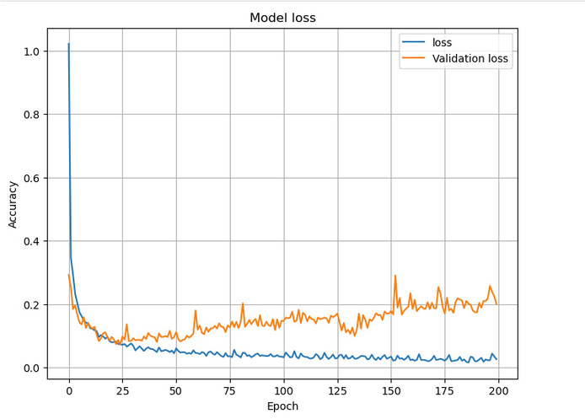
Model Building and Training

Slide 15
Model Deployment and Video Input Handling
Model Deployment on Jupyter notebook
Key Steps in the Feedback Process
Video Input
Input: A video file containing yoga poses.
The video is processed frame by frame using OpenCV.
Pose Detection
MediaPipe Pose module detects landmarks (key body points) in each frame.
c. Joint Angle Calculation
Vector Representation:
Landmarks form vectors representing body parts (e.g., shoulder to elbow).
Angles are computed between vectors using the compute_angle function.
Angles Computed:
Example: Left elbow angle is calculated using the shoulder, elbow, and wrist landmarks.
d. Pose Classification from video
The extracted angles are passed as input to a trained deep learning model.
The model predicts the yoga pose (e.g., Warrior II, Downward Dog).

Slide 16
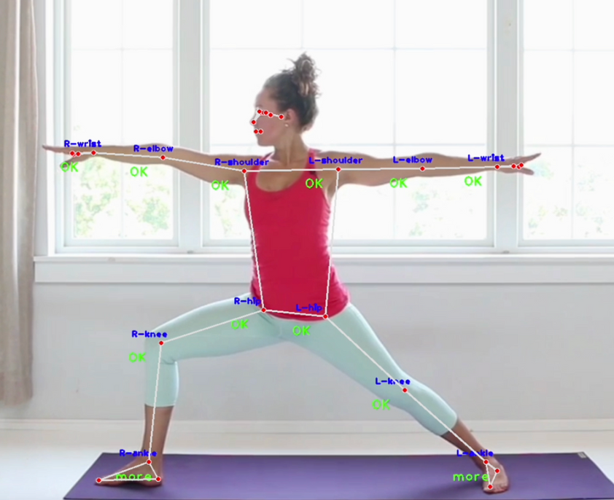
Correction of pose in the video
Feedback Mechanism
a. Reference Angle Comparison
Reference Data:
Predefined angle values for each pose are stored in a CSV file.
Angles generated from predicted pose are compared with reference angles.
Angles are categorized as:
"More": Too extended.
"Less": Not extended enough.
"OK": Within acceptable range.
b. Overall Posture Assessment
Each pose has a threshold for the number of correct angles.
If the number of correct angles meets the threshold, the pose is classified as CORRECT, otherwise WRONG.
c. Accuracy Calculation
For each angle:
Accuracy= 1- (∣Observed Angle−Reference Angle∣​divided by Reference Angle)
The average accuracy of all angles is displayed.

Slide 17

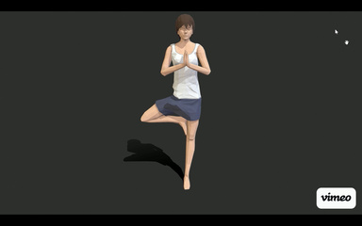

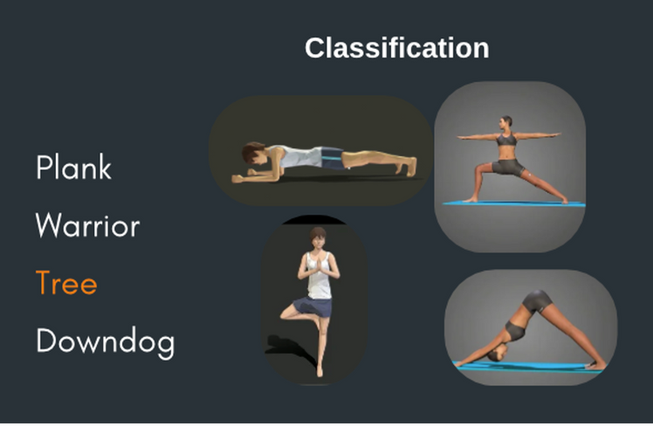

Workflow for Correct Yoga Pose Estimation and Feedback Generation
FEATURE EXTRACTION
INPUT VIDEO
CALCULATING JOINTS
AND ANGLES
EXTRACTED FRAMES
DETECTED KEYPOINTS
FEEDBACK GENERATION
SUGGESTIONS
CALCULATING DEVIATION AND DIRECTION

Slide 18
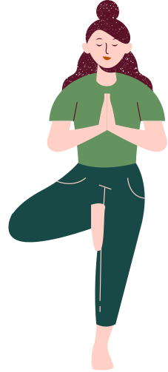

05
Accuracy Levels
Results
Accuracy of 0.97 was achieved video pose recognition within controlled environments.

Slide 19
Results
(Check output_video.mp4)

Slide 20
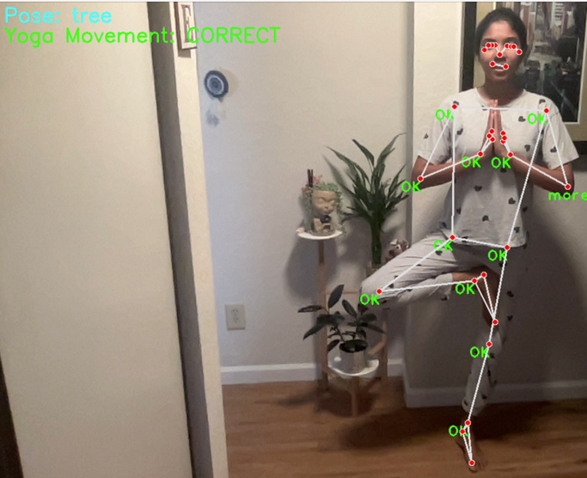
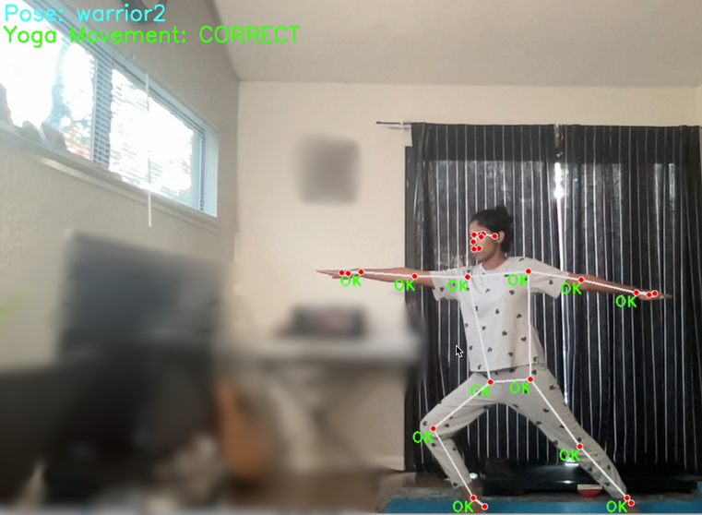
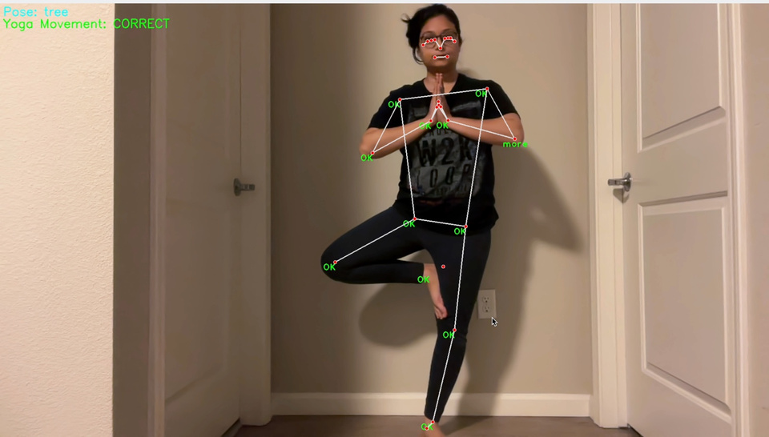

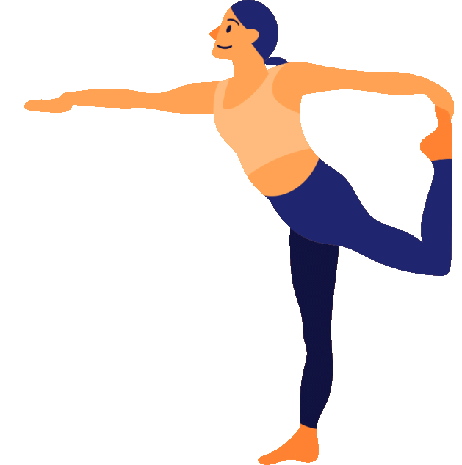




Web Cam Results

Slide 21

06
Contributions & Implications

Slide 22
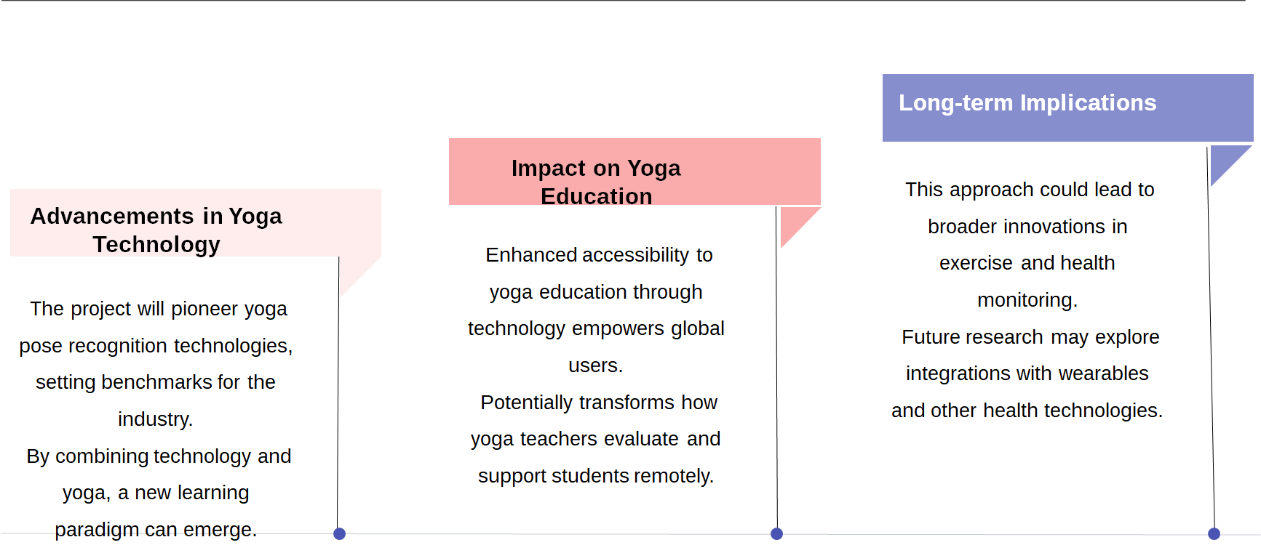
Contributions and Implications

Slide 23
Challenges
Intuition and Human connection
User Personalization
Training with large
amounts of data
Unlike human trainers, AI lacks emotional understanding, empathy, and the ability to intuitively adapt guidance based on users' mood, energy, or comfort level.
Modifying AI models to tailor feedback to individual needs, such as flexibility, injuries, or progress, demands complex algorithms and continuous adaptation.
Extensive datasets covering diverse poses, transitions, and body types.
Acquiring and labeling such data accurately is resource-intensive.

Slide 24
References
https://norma.ncirl.ie/6321/1/jothikasunney.pdf
https://onlinelibrary.wiley.com/doi/10.1155/2022/4311350
https://www.w3schools.com/python/trypython.asp?filename=demo_ref_math_atan2
https://arxiv.org/pdf/2201.07594
https://ijirt.org/publishedpaper/IJIRT167546_PAPER.pdf
https://archivepp.com/storage/models/article/X7CQtiRRH3VDs0GMJ6IiZ95wgF5cR1PD99hVoIBVgeFQqvacDAmuL4LLrQuE/injuriesharms-resulting-from-incorrect-adjustmentsalignments-performed-by-yoga-asana-practitioners.pdf
https://sketchfab.com/3d-models/yoga-pose-virabhadrasana-ii-d64fbdb70eb4471ca4080ee4958c3645
https://sketchfab.com/3d-models/yoga-tree-pose-exercise-28172f6e0cd34323bfd142973dcd9a8b
https://sketchfab.com/3d-models/yoga-plank-exercise-deff1c0b4cd04da3a4a39e71e227db81
https://sketchfab.com/3d-models/downward-facing-dog-yoga-pose-ae76cb29b8b84c4299d158cf76977c58
https://onlinelibrary.wiley.com/doi/10.1155/2022/4311350

Slide 25

Thank you..

